Slide 1
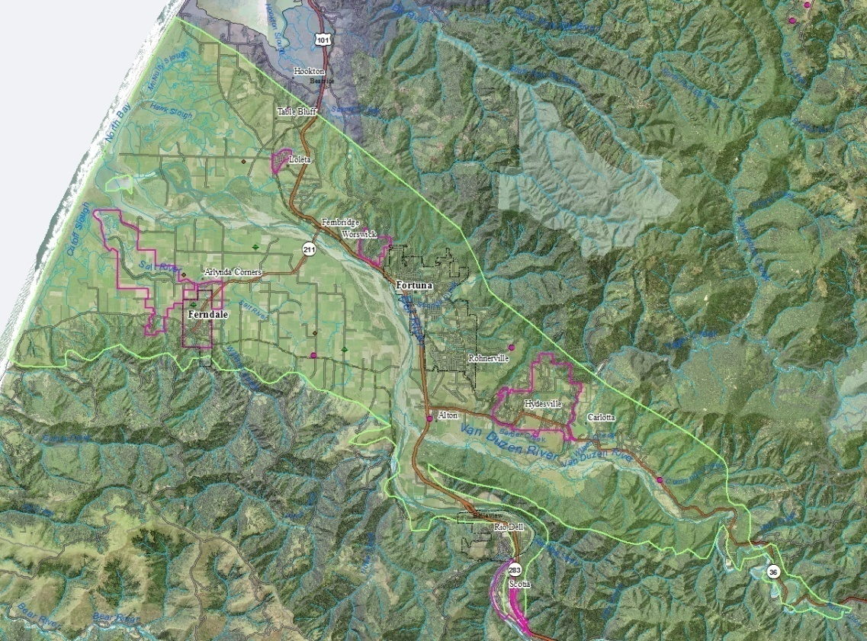

Eel River Valley
Groundwater Working Group
September 30, 2019 // 10:00 am – 11:30 am
Humboldt County Agricultural Center
Department of Public Works
http://humboldtgov.org/groundwater

Slide 2
Today’s agenda
Introductions
DWR’s assessment of the Groundwater Sustainability Plan Alternative submittal
Background
Basis for DWR’s assessment
Brief review of monitoring data
What would disapproval mean
Next steps
Discuss formation of a Groundwater Sustainability Agency
Prop. 68 grant opportunity
Schedule next meeting
September 30, 2019

Slide 3
Today’s agenda
Introductions
DWR’s assessment of the Groundwater Sustainability Plan Alternative submittal
Background
Basis for DWR’s assessment
Brief review of monitoring data
What would disapproval mean
Next steps
Discuss formation of a Groundwater Sustainability Agency
Prop. 68 grant opportunity
Schedule next meeting
September 30, 2019

Slide 4
DWR’s Assessment of the GSP Alternative for the Eel River Valley groundwater basin
A Groundwater Sustainability Plan Alternative is “an analysis of basin conditions that demonstrates that the basin has operated within its sustainable yield over a period of ten years.” Water Code §10733.6(b)(3)
Summary of DWR’s Primary Points:
Objective management criteria were not established for at least 10 years prior to 2014.
The GSP Alternative does not sufficiently demonstrate the absence of all undesirable results.
A quantitative estimate of sustainable yield has not been developed.
The GSP Alternative should have quantified the impacts of groundwater use on surface water systems and determined at what point they are significant and unreasonable.
DWR does not conclude that the basin is, or has been, managed unsustainably.
September 30, 2019

Slide 5
Brief review of monitoring data

Slide 6
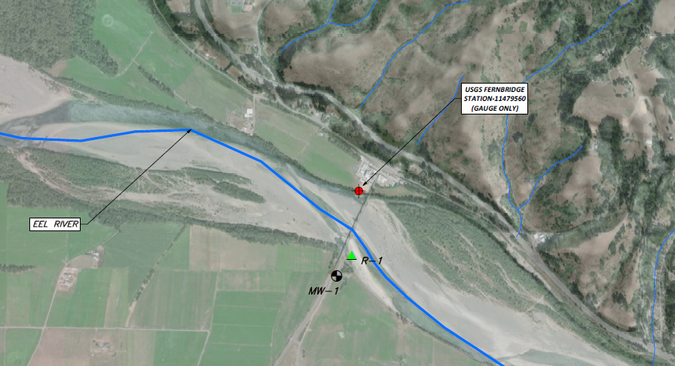
Monitoring Stations MW-1, R-1

Slide 7
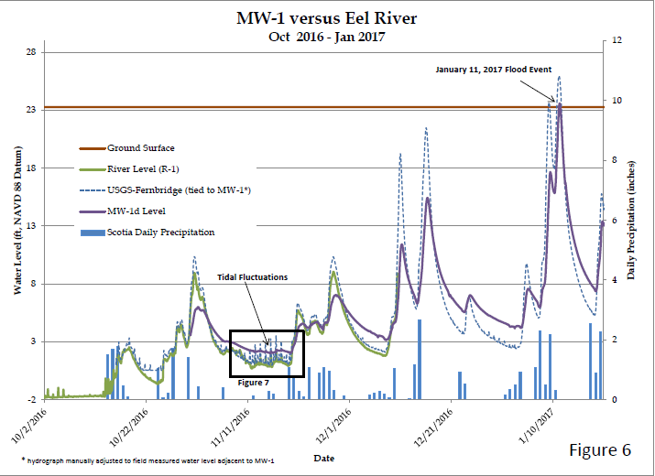

Slide 8
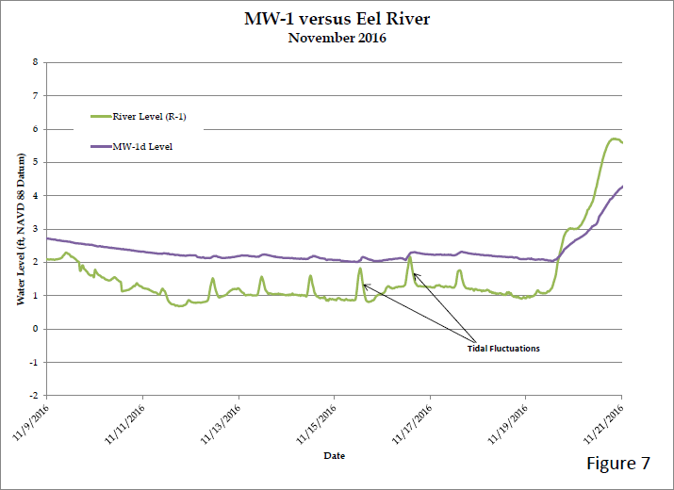

Slide 9
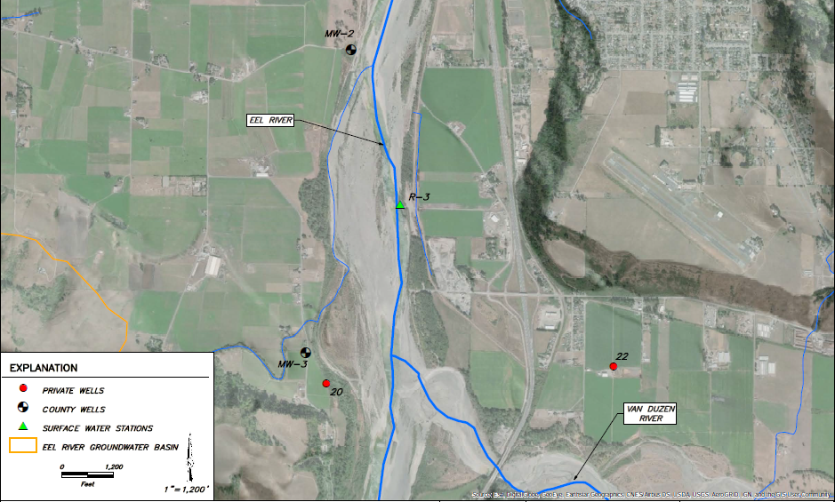
Monitoring Stations MW-2, MW-3, R-3

Slide 10
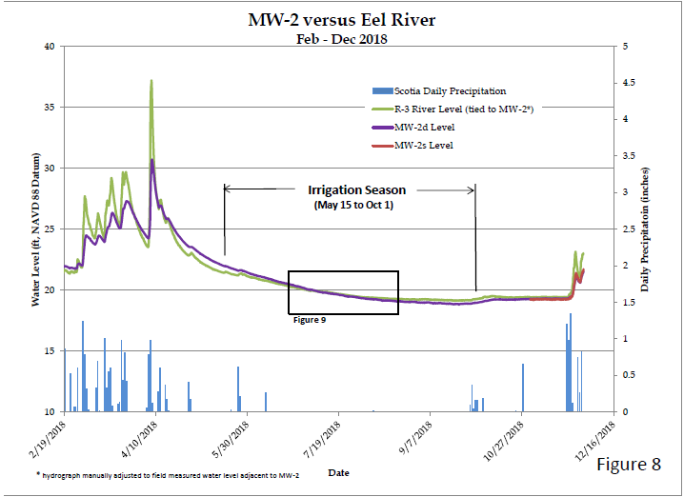

Slide 11
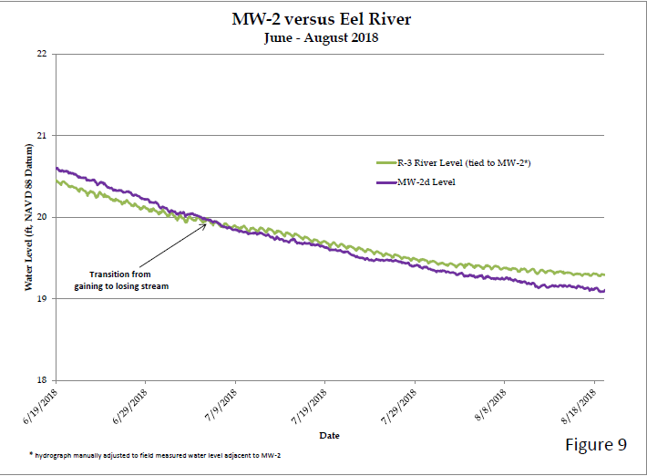

Slide 12
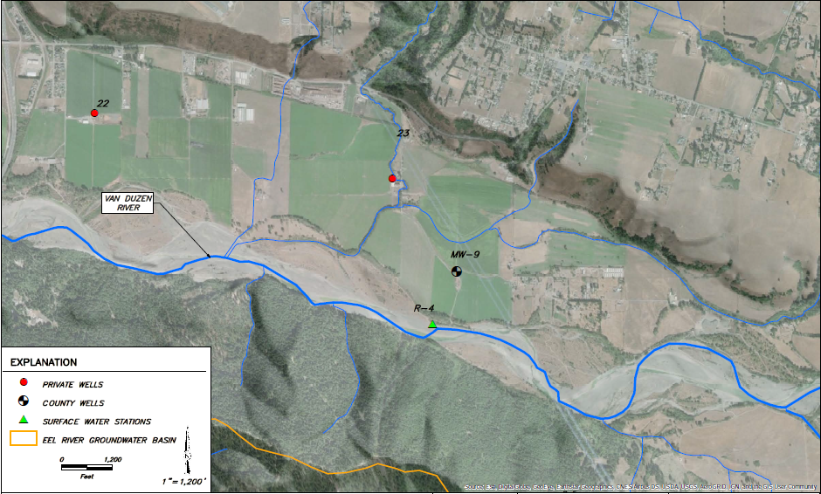
Monitoring Stations MW-9, R-4

Slide 13
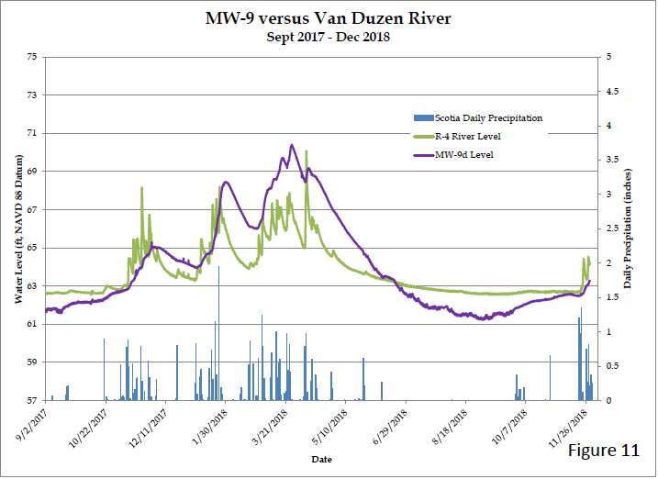

Slide 14
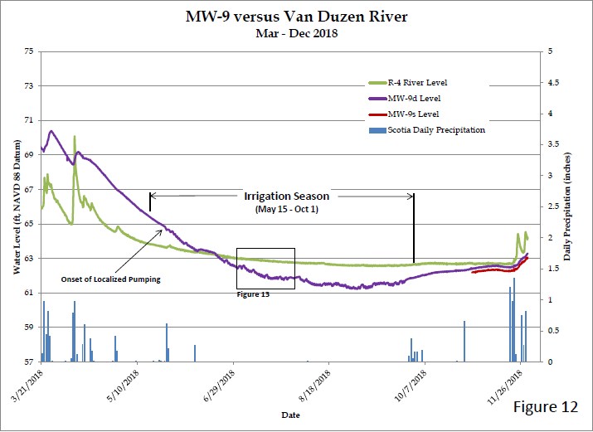

Slide 15
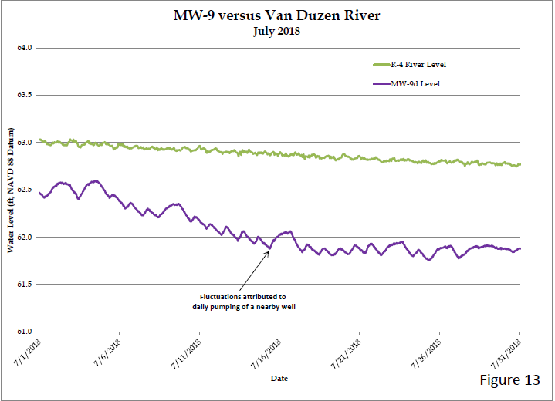

Slide 16
DWR’s Assessment of the GSP Alternative for the Eel River Valley groundwater basin
A Groundwater Sustainability Plan Alternative is “an analysis of basin conditions that demonstrates that the basin has operated within its sustainable yield over a period of ten years.” Water Code §10733.6(b)(3)
Summary of DWR’s Primary Points:
Objective management criteria were not established for at least 10 years prior to 2014.
The GSP Alternative does not sufficiently demonstrate the absence of all undesirable results.
A quantitative estimate of sustainable yield has not been developed.
The GSP Alternative should have quantified the impacts of groundwater use on surface water systems and determined at what point they are significant and unreasonable.
DWR does not conclude that the basin is, or has been, managed unsustainably.
September 30, 2019

Slide 17
What would disapproval of the GSP Alternative mean?
A Groundwater Sustainability Agency (GSA) would need to be formed.
A Groundwater Sustainability Plan would need to be developed by January 2022.
If DWR takes final action to disapprove the GSP Alternative and a GSA is not formed within 180 days, the State Water Resources Control Board would have the authority to designate the Eel River Valley groundwater basin a “probationary basin.” If the State Water Resources Control Board makes this designation, the State Board would then have the authority to require extraction reporting from groundwater users and charge extraction fees.
September 30, 2019

Slide 18
Today’s agenda
Introductions
DWR’s assessment of the Groundwater Sustainability Plan Alternative submittal
Background
Basis for DWR’s assessment
Brief review of monitoring data
What would disapproval mean
Next steps
Discuss formation of a Groundwater Sustainability Agency
Prop. 68 grant opportunity
Schedule next meeting
September 30, 2019

Slide 19
GSA Examples
Del Norte County (Smith River Plain)
The Board of Supervisors designated Del Norte County as the GSA
This basin was subsequently designated as low priority by DWR
Mendocino County (Ukiah Valley Basin)
A GSA was formed through a Joint Powers Agreement with six Directors (four public agency seats and two stakeholder seats)
The GSA board receives input and recommendations from an advisory committee
Sonoma County (Santa Rosa Plain)
A GSA was formed through a Joint Powers Agreement with nine Directors (eight public agency seats and a PUC-regulated mutual water company)
The GSA board receives input and recommendations from an advisory committee
September 30, 2019

